Slide 1
Fast Byzantine Consensus
Jean-Philippe Martin, Lorenzo Alvisi
Presented by:
Dhruvatara Bhogishetty
Jayneel Vora

Slide 2
Consensus Problem

Slide 3
Liveness properties.
FAST
BYZANTINE
CONSENSUS
Safety properties
Something good eventually happens.
Nothing bad happens.
1. Only a value that has been proposed can be chosen.
1. Some proposed value is eventually chosen.
2. Only a single value may be chosen.
2. Once a value is chosen, correct learners eventually learn it.
3. Only the chosen value may be learnt by a correct learner.
Notes:
no reachable ERROR/STOP state
an action is eventually executed

Slide 4
FAST
BYZANTINE
CONSENSUS
FaB Paxos
Completes in two steps
5f+1 acceptors and tolerates f Byzantine faults.
Parameterized FaB-
2 step: till t acceptors fail.
3f+2t+1 acceptors to tolerate f Byzantine faults.
Both are tight- use minimal number of processes.

Slide 5
Replication- is it more expensive?

Slide 6
Related Protocols
FastPaxos
Kursawe’s optimistic protocol
Failure detector based protocols
Lamport’s conjecture (N> 2Q+F+2M)
Notes:
FastPaxos-Processes can only fail by crashing FaB Paxos
Processes can fail arbitrarily
FP: Requires only 2f+1 acceptors FaB:Requires >= 5f+1 acceptors FP:Can deliver consensus in two communication steps in stable periods FaB:Can deliver consensus in two communication steps during gracious execution FP: Relies on an eventual leader oracle
FaB: Relies on eventual synchrony(for leader election)
Kursawe’s protocol Requires only 3f+1 acceptors. FaB Paxos Requires only 5f+1 acceptors KP: Can deliver consensus in two communication steps as long as channels are timely and no process is faulty FaB: Can deliver consensus in two communication steps during gracious execution
Other protocols that use failure detectors can achieve two-step communication iff failure detector works correctly and coordinator does not fail.
Oracle-based protocol by Friedman et al. can complete in single step communication if all correct nodes start with the same proposal

Slide 7
Let’s talk assumptions.
Unreliable network
Processes or communication links.
Authenticated Asynchronous Fair Links.

Slide 8
What does it look like?
N- number of nodes
* A particular node can be more than 1 type
Proposers
3f+1
Acceptors
5f+1
Learners
3f+1
Digital signatures
Encryption.
Cryptographic primitives are GOD like- unbreakable.
We ensure safety at all times.
Guarantee liveness during periods of synchroncy.
Notes:
Digital signatures are used ONLY for leader elections!
Alll acceptors and proposers have public/private keys.
Cryptographic primitives are GOD like- unbreakable.

Slide 9
Getting our hands dirty- common case.
Unique correct leader.
All correct acceptors agree on its identity.
System is in a period of synchrony.
Leader proposes its value to ALL acceptors.
CS 1
satisfied!
Acceptors accept the first value v, forward it to learners.
CS 2
satisfied!
Learners learn v
⌈(a+3f+1)/2⌉ acceptors have accepted it.
CS 3
satisfied!
Notes:
What about liveliness? It is also a period of synchrony!

Slide 10
Let’s get into the asynchronous world.
Fair asynchronous authenticated links.
May take more than 2 communication steps.
Sends message continuously.
CALLER
CALLEE
Sends reply each time!
Stops sending once it is satisfied.
Retranmission policy.
Notes:
Why will it take more than 2 communication steps?

Slide 11
Making sure the leader is making progress!
⌈(p+f+1)/2 ⌉
If do not hear from ⌈(l+f+1)/2⌉ learners-> suspicion!
If ⌈(p+f+1)/2⌉ suspect, ELECTION!!!!!

Slide 12
Formalising the Leader Election
Every proposer has a leader-election object.
Input: the node which they suspect to be faulty.
Output: regency number r -> non decreasing!
Proof^{r} is generated when r is elected.
New leader: r mod p
Guaranteed:
if no correct node suspects leader-> current leader doesn’t change!
If ⌈(p+f+1)/2⌉ suspect r, output r’ will be different.
New leader invokes the recovery protocol!

Slide 13
Special Scenarios with
Recovery protocol
Already chosen value, before election.
Poisonous write

Slide 14
Progress certificates
Find if any value was chosen!
What is the use of collecting progress certificates?
How does it help with poisonous writes?
How does the proposal work?

Slide 15
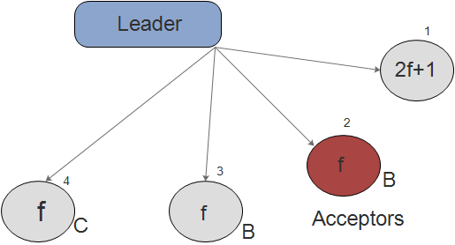
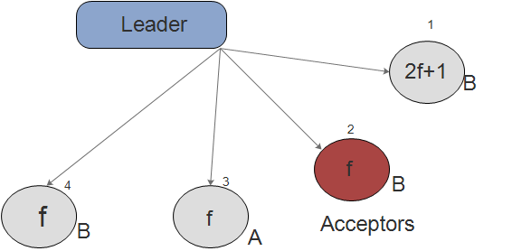
Constructing-Progress certificates
Simple Approach: Currently accepted value, signed from a-f acceptors.
Problem: A progress certificate can be used twice to get 2 different values to be chosen!
A

Slide 16
Constructing-Progress certificates
Changes:
New value, once.
Acceptors accept only 1 proposal for every proposal number.
Proposal number and proposed value are tied.

Slide 17
Correctness- Safety and Liveness.
CS1. only a value that has been proposed may be chosen.
CS2. only a single value may be chosen.
Lemma 1: For every proposal number pn, at most one value is chosen.
Lemma 2: If value v is chosen for proposal pn, then every progress certificate for proposal number pn′ > pn will vouch for v and no other value.
CS3. only a chosen value may be learned by a correct learner.
Lemma 3: Some value is eventually stable.
CL1. Some proposed value is eventually chosen
CL2. Once a value is chosen, correct learners eventually learn it.

Slide 18
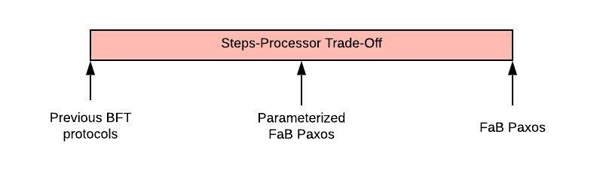
Parameterized FaB Paxos.
Notes:
FaB Paxos requires 5f+1 processes, 2 comm steps with f failures- additional replication is for speed. Generalize FaB paxos by removing the replication done for speed- resulting protocol is Parameterized FaB Paxos. Makes a trade-off between communication steps and additional processes (trade off parameter called t). Requires 3f+2t+1 processes, safe up to f BFs, comm in 2 steps up to t failures. Merges 3PC with FaB Paxos to manage liveliness with lesser processes

Slide 19
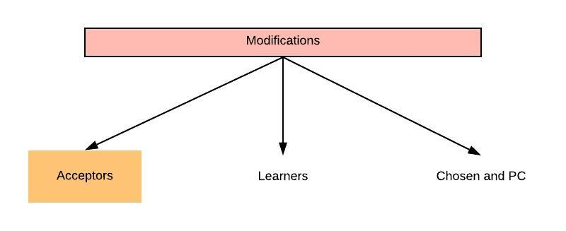
Parameterized FaB Paxos
Notes:
Acceptors collect a commit proof- consists of (a+f+1)/2 statements from different acceptors that agreed to value v for a proposal number pn. Commit proof is included in PC so that leaders have info when they have to decide a new value; it is also forwarded to learners to guarantee liveness when more than t acceptors fail.

Slide 20
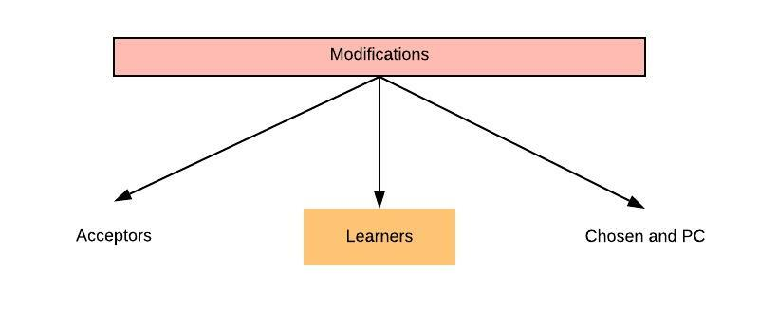
Parameterized FaB Paxos
Notes:
Learners learn on the basis of commit proof. Value is chosen for pn if [a+f+1]/2 A’s accepted pn or have commit proof for v and pn

Slide 21
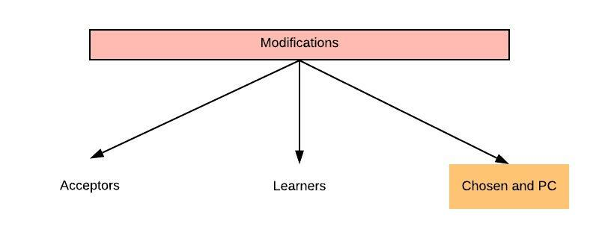
Parameterized FaB Paxos
Notes:
Each element of PC has additional element- commit proof or stm saying no commit proof. PC vouches for a value at a prop number if it doesn’t have commit proof for any other value, and if >= (a-f+1)/2 entries in the PC having prop number pn have value v.

Slide 22
Proof of optimality
No distinction between nodes.
Event types.
Local history.
Protocol:
Send message to every other process.
Wait for n-f distinct processes to return message.
Perform sequence of local events.

Slide 23
Proof of optimality
Configuration
View of process in execution
Similar executions
Consensus value
F-silent
Two step execution
(t,2) step
(t,2) step bivalent
Notes:
can tolerate
f Byzantine failures and if for every initial configuration
I and every set F of at most t processes (t ≤ f), there
exists a two-step execution of the protocol from I that
is F-silent. If the protocol is (f,2)-step then we simply
say that it is two-step.

Slide 24
Proof of optimality
Any (t,2) step Byzantine fault tolerant consensus protocol requires at least 3f+2t+1 processes.
Contradict! Assume, 3f+2t processes. Partition them into 5 sets.
F0=p5 and F1=1, having size t. Other sets- size f.
Si- start of pi at end of first round of p0
Ti- start of pi at end of first round of p1

Slide 25
Proof of optimality
Three new executions of P:
Ps,Pt,Pc
All three are p3-silent from the second round.

Slide 26
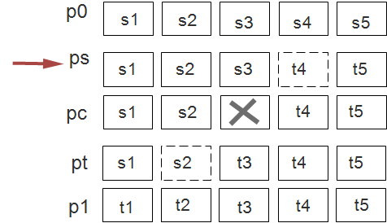
Ps scenario
P4 has byzantine processes.
View of p3 is same as in second round of p0.
Hence p3 learns 0.

Slide 27
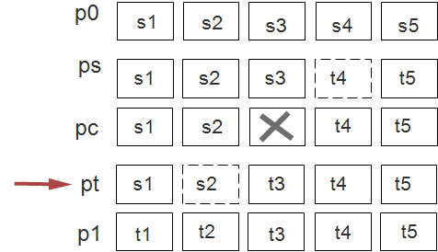
Pt scenario
P2 has byzantine processes.
View of p3 is same as in second round of p1.
Hence p3 learns 1.

Slide 28
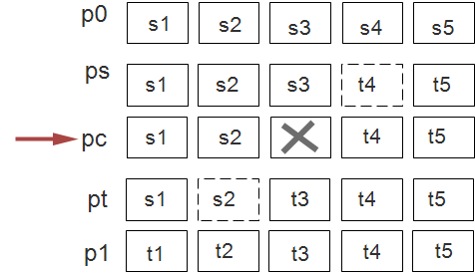
Pc scenario
Pc crashed.
Need to learn value!
By construction, c(pc)=c(ps)=0 AND c(pc)=c(pt)=1,
Which can’t be true, hence it is not possible.

Slide 29
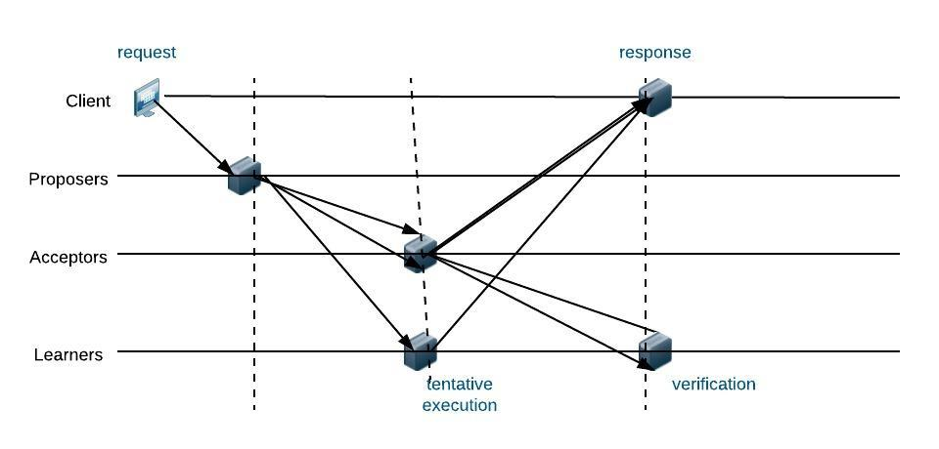
State Machine Replication
Notes:
SMR is most general method for implementing fault tolerant services in distributed systems. FaB requires one fewer round for state machine replication. 4 rounds- Client -> proposers; 2 rounds for learners to learn correct order; Learner executes and sends reply to clients. One way to reduce it to 3 rounds = tentative execution: Learners execute requests in a tentative order; Acceptors send info to clients and learners both to decide consensus- both C and L at the same time decide if leader was faulty or not; If any conflict, tentative execution rolled back and requests re-executed in correct order.

Slide 30
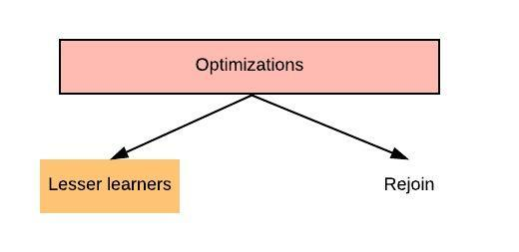
Optimizations
Notes:
2f+1 learners- Parameterized FaB Paxos requires 3f+1 learners- can reduce this number to 2f+1 by adding signatures. With 3f+1 learners, retransmission stops when (l+f+1)/2 learners learn the consensus value- rest will learn by querying each other. With 2f+1 learners, retransmission stops when proposer gets f+1 acks from learners. Acks contain client request, learner response and f+1 signatures that verify the response. Learners sign their response and send to others- since there are f+1 correct learners, each correct learner will get f+1 signatures verifying its response. Leader is satisfied that at least one of the leaders who sent valid ack is correct and supports pull protocol. Exchange of signatures doesn’t block critical path- occurs after learners learn a value. Doesn’t block consensus protocol also- learners execute request immediately without waiting for f+1 signatures- client can differentiate between correct and wrong replies since correct is vouched by f+1 replies

Slide 31
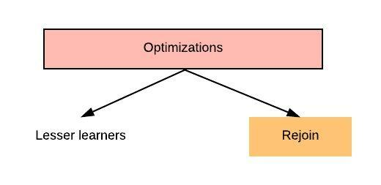
Optimizations
Notes:
Rejoin- Allows repaired servers to rejoin. System can continue to work as long as no more that f are faulty or rejoining the system. Rejoin must restore the replica’s state: If rejoining proposer- query acceptors for proof of leadership and adopt largest valid response; If rejoining acceptor- collect last consensus d from other acceptors, ignore instances till d+k. Once system moves to d+k, rejoin process finished; If rejoining learner- query other learners for list of operations. Accept the answers vouched for by l+1 learners.

Slide 32
Conclusion
Fab Paxos
Can achieve consensus in 2 communication steps in common case.
Is optimal- minimal no of steps for consensus, number of processes.
Does not require expensive digital signatures.
Good trade off for extra communication step.
5f+1 acceptors is the lower bound for two-step termination, it is possible to complete it in 2 communication steps with fewer acceptors.
Parameterized FaB Paxos decouples fault-tolerance from 2step termination by spanning the design space between a byzantine consensus protocol with minimal number of servers.
Parameterized FaB Paxos requires 3f+2t+1 servers to tolerate f Byzantine failures and completes in 2 communication steps- where there are at most t failures.

Slide 33
Thank you!

